Slide 1

Food Delivery Website
CB2_3
Ajaykumar P | (612820104001)
Ajith S | (612820104002)
Ajith kumar M | (612820104003)
Gnana vignesh K | (612820104007)

Slide 2



Your Project Name
Your Project Introduction
LMS Username | Name | Batch
au612820104001 | Ajaykumar P | CB2_3
au612820104002 | Ajith S | CB2_3
au612820104003 | Ajith kumar M | CB2_3
au612820104007 | Gnana vignesh K | CB2_3

Slide 3

Task - 1
Creation of SRS & Github
Create SRS : “Your Project”
Creation & Set-up of Github account
Creation & Hands-on to various commands of Git Bash
Evaluation Metric:
100% Completion of the above tasks
Learning Outcome
Get to know about different lifecycle models.
Understanding importance and how to create an SRS
Knowing various commands of Github
Understanding agile and scrum management techniques for efficient product development

Slide 4
Introduction
In today's fast-paced world, the demand for online food ordering and delivery services has
seen exponential growth. With the rise of digital technology, people now prefer the convenience of ordering food from their favorite restaurants with just a few clicks. The "Foodie-Hub" project aims to address this growing demand by creating an innovative and user- friendly food ordering website that connects customers with local restaurants. This project is designed to offer a seamless and efficient food ordering experience for users while helping restaurants increase their visibility and reach a broader audience.

Slide 5
Project Overview
The initial phase of the Food-Ease project will concentrate on serving a
specific geographic area or city. As the platform gains popularity and trust, it will expand to cover a wider region. Collaboration with a variety of local restaurants and cuisines will be a priority to offer an extensive selection to users. Future plans may include mobile application development, additional features, and expansion into new markets.

Slide 6
Project Phases
Planning
Design
Development
Testing
Launch
Maintenance and Updates

Slide 7
Existing System
The existing system varies from one food ordering website to another,
and while many share common features, there may be differences in terms of design,
user experience, and additional functionality. The system is designed to make online
food ordering convenient for users and to support local restaurants in expanding their customer base.

Slide 8
Proposed System
The proposed system for the food ordering website project combines user-
friendly features for both customers and restaurant owners, secure payment processing,
efficient order tracking, and comprehensive support. It is designed to provide a seamless and convenient food ordering experience while supporting local restaurants and delivery services.

Slide 9
Requirement
Software Configuration:
Operating System: Windows NT, windows 98, Windows XP
Language: Java Runtime Environment, Net beans 7.0.1 (front end)
Database: MS SQL Server (back end)

Slide 10
Hardware Configuration:
Processor: Pentium(R)Dual-core CPU
Hard Disk: 40 GB
RAM: 2 GB
Content Delivery Network (CDN): CDN to deliver static
Web Hosting Server: AWS, Azure, Google Cloud

Slide 11

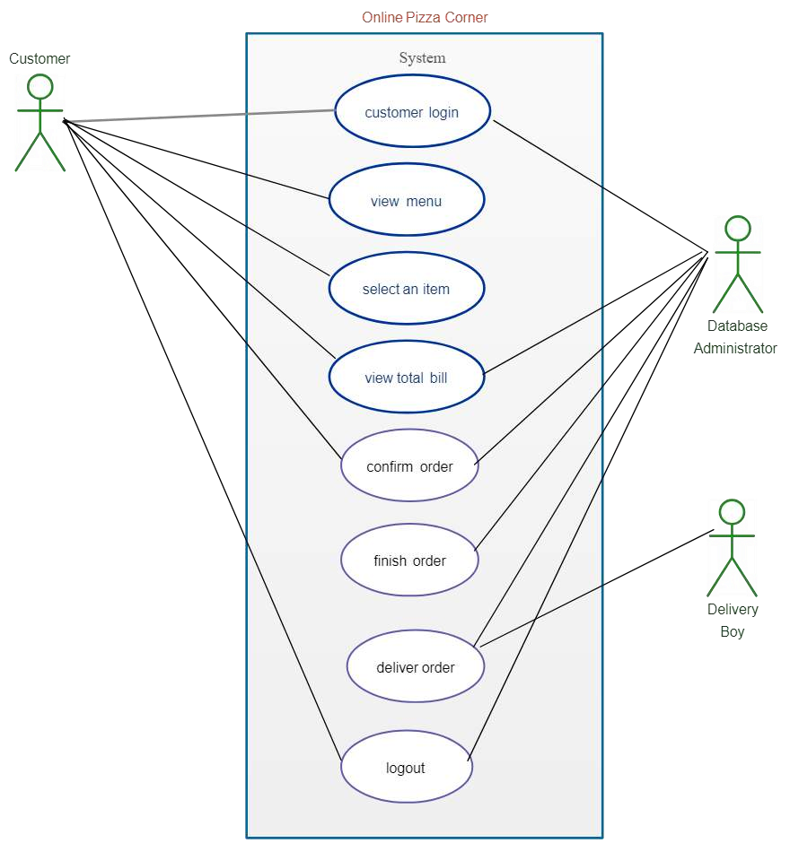
Use case Diagram

Slide 12

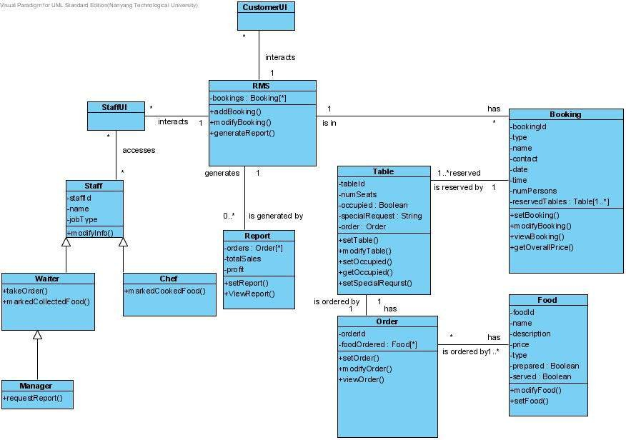
Class Diagram

Slide 13
Conclusion
Food Ease is committed to becoming the preferred platform for hassle-free
food ordering and delivery. We aim to transform the way people experience dining by making the process as easy as a few clicks. Our project not only caters to the needs of individual customers but also supports local restaurants in thriving within the digital age. Food Ease promises to make food ordering a delightful experience for everyone.

Slide 14

Assessment Parameter
Gather requirements for the
project
add Readme.md file with
description of the project
Prepare database design
schemas
Check-List
Commit all changes with "first commit"
Get your initial project
Structure ready
create a repository on github related to project
Initiate a git repository
Push your changes to github

Slide 15


Submission Github
https://github.com/Ajaykumar6128
https://github.com/Ajith498
https://github.com/GnanaVigneshcse

Slide 16


